Slide 1
Introduction to Data Science
Lecture 10
Machine Learning Part 2a
SEAS 6401 Fall 2019
Benjamin Harvey

Slide 2

OVERVIEW
Introduction
Background (mine and yours)
Organizational Personas
DoD Siloed and Proprietary Systems
Intelligence & Genomic Signals Analysis Processes
Problem: Bias and Fairness in Machine Learning
Bias
Fairness
Solution: Governance Framework for ML Algorithms
Explainability
Transparency
Accountability
ML/AI Governance Platform: Managing the ML Lifecycle
Open Source MLflow

Slide 3


Organizational ML/AI Personas
Persona
Offering
Details
Analyst/
Warfighter
/ Integrated in Application
/ AI Transparent to the User
/ Augmentation vs. Decision Making
UI Conversational Agents, Recommendation Systems
Citizen
Data Scientist
AutoML Toolkit
/ Feature Factory
/ Feature Importance
/ Evolutionary Model Search
ML Engineer
/ Hyperparameter Tuning
/ Model Architecture Search
ML Frameworks and MLflow
ML Expert / Researcher
/ Distributed Execution of Libraries
/ Latest AutoML Libraries (e.g. Uber’s Ludwig)
/MLLib, Horovod, Hyperopt
ML Framework Optimizations
Sources of Bias: These (1) personas interact with the (2) model and the (3) data

Slide 4






THE “Tipping Point” PROBLEM
Find a balance between Microarray Gene Quality (MGQ) & accuracy/performance in Large-Scale Cancer Genomic (LSCG) datasets for efficient cancer patient and cell line classification.
Increase the robustness by utilizing a “Tipping Point” gauge in a cloud-scale distributed parallel (CSDP) environment.
StarCluster @
Packages: BiocParallel, GGtools
Notes:
“How do we”

Slide 5
ML/AI Bias and Fairness
What is Bias in Data
Types of Bias
Bias in Practice
Bias Variance Tradeoff
Algorithmic Fairness
Types of Discrimination
Combatting Bias

Slide 6
What is Bias
Data, especially big data, is often heterogeneous, generated by subgroups with their own characteristics and behaviors. The heterogeneities, some of which are described below, can bias the data. A model learned on biased data may lead to unfair and inaccurate predictions.
The bulls eye is the model

Slide 7
ML/AI Bias and Fairness
Bias in Data
Types of Bias
Bias in Practice
Bias Variance Tradeoff
Algorithmic Fairness
Types of Discrimination
Combatting Bias

Slide 8
Types of Bias
(1) Historical Bias. Historical bias is the already existing bias and socio-technical issues in the world and can seep into from the data generation process even given a perfect sampling and feature selection.
(2) Representation Bias. Representation bias happens from the way we define and sample from a population.
(3) Measurement Bias. Measurement bias happens from the way we choose, utilize, and measure a particular feature.
(4) Evaluation Bias. Evaluation bias happens during model evaluation.
(5) Aggregation Bias. Aggregation bias happens when false conclusions are drawn for a subgroup based on observing other different subgroups or generally when false assumptions about a population affect the model’s outcome and definition.
Notes:
An example of this type of bias can be found in a 2018 image search result where searching for women CEOs ultimately resulted in fewer female CEO images due to the fact that only 5% of Fortune 500 CEOs were woman—which would cause the search results to be biased towards male CEOs [118]. These search results were of course reflecting the reality, but whether or not the search algorithms should reflect this reality is an issue worth considering.
Lacking geographical diversity in datasets like ImageNet (as shown in Figures 3 and 4) is an example for this type of bias [118]. This demonstrates a bias towards Western countries.
An example of this type of bias was observed in the recidivism risk prediction tool COMPAS, where prior arrests and friend/family arrests were used as proxy variables to measure level of “riskiness” or “crime”—-which on its own can be viewed as mismeasured proxies. This is due to the fact that minority communities are controlled and policed more frequently, so they have higher arrest rates. However, one should not conclude that because people coming from minority groups have higher arrest rates therefore they are more dangerous as there is a difference in how these groups are assessed and controlled [118].
This includes the use of inappropriate and disproportionate benchmarks for evaluation of applications such as Adience and IJB-A benchmarks. These benchmarks are used in the evaluation of facial recognition systems that were biased toward skin color and gender [23], and can serve as examples for this type of bias [118].

Slide 9
Types of Bias
(6) Population Bias. Population bias arises when statistics, demographics, representatives, and user characteristics are different in the user population represented in the dataset or platform from the original target population.
(7) Simpson’s Paradox. Simpson’s paradox can bias the analysis of heterogeneous data that is composed of subgroups or individuals with different behaviors.
A trend, association, or characteristic observed in underlying subgroups may be quite different from association or characteristic observed when these subgroups are aggregated
(8) Longitudinal Data Fallacy. Observational studies often treat cross-sectional data as if it were longitudinal, which may create biases due to Simpson’s paradox
(9) Sampling Bias. Sampling bias arises due to non-random sampling of subgroups. As a consequence of sampling bias, the trends estimated for one population may not generalize to data collected from a new population.
(10) Behavioral Bias. Behavioral bias arises from different user behavior across platforms, contexts, or different datasets.
Notes:
An example of this type of bias can arise from different user demographics on different social platforms, such as women being more likely to use Pinterest, Facebook, Instagram, while men being more active in online forums like Reddit or Twitter. More of such examples and statistics related to social media use among young adults according to gender, race, ethnicity, and parental educational background can be found in [56].
According to Simpson’s paradox, a trend, association, or characteristic observed in underlying subgroups may be quite different from association or characteristic observed when these subgroups are aggregated. One of the better-known examples of this type of paradox arose during the gender bias lawsuit in university admissions against UC Berkeley [15]. After analyzing graduate school admissions data, it seemed like there was bias toward women, a smaller fraction of whom were being admitted to graduate programs compared to their male counterparts. However, when admissions data was separated and analyzed over the departments, women applicants had equality and in some cases even a small advantage over men. The paradox happened as women tended to apply to departments with lower admission rates for both genders. Simpson’s paradox has been observed in a variety of domains, including biology [34], psychology [68], astronomy [89], and computational social science [77].
. As an example, analysis of bulk Reddit data [9] revealed that comment length decreased over time on average. However, bulk data represented a cross-sectional snapshot of the population, which in reality contained different cohorts who joined Reddit in different years. When data was disaggregated by cohorts, the comment length within each cohort was found to increase over time.
For the intuition, consider again the example in Figure 1. Suppose the next time the study is conducted, one of the subgroups is sampled more frequently than the rest. The positive trend found by the regression model in the first study almost completely disappears (solid red line in plot on the right), although the subgroup trends (dashed green lines) are unaffected.
An example of this type of bias can be observed in [88], where authors show how differences in emoji representations among platforms can result in different reactions and behavior from people and sometimes even leading to communication errors.

Slide 10
Types of Bias
(11) Content Production Bias. Content Production bias arises from structural, lexical, semantic, and syntactic differences in the contents generated by users.
(12) Linking Bias. Linking bias arises when network attributes obtained from user connections, activities, or interactions differ and misrepresent the true behavior of the users.
(13) Temporal Bias. Temporal bias arises from differences in populations and behaviors over time..
(14) Popularity Bias. Items that are more popular tend to be exposed more. However, popularity metrics are subject to manipulation—for example, by fake reviews or social bots.
(15) Algorithmic Bias. Algorithmic bias is when the bias is not present in the input data and is added purely by the algorithm.
(16) User Interaction Bias. User Interaction bias is a type of bias that can not only be observant on the Web but also get triggered from two sources—the user interface and through the user itself by imposing his/her self-selected biased behavior and interaction. This type of bias can be influenced by other types and subtypes, such as Presentation and Ranking biases.
Presentation Bias. Presentation bias is a result of how information is presented. For example, on the Web users can only click on content that they see, so the seen content gets clicks, while everything else gets no click. And it could be the case that the user does not see all the information on the Web.
Ranking Bias. The idea that top-ranked results are the most relevant and important will result in attraction of more clicks than others. This bias affects search engines and crowdsourcing applications.
Notes:
An example of this type of bias can be seen in [97] where the differences in use of language across different gender and age groups is discussed. The differences in use of language can also be seen across and within countries and populations.
(12) Linking Bias. Linking bias arises when network attributes obtained from user connections, activities, or interactions differ and misrepresent the true behavior of the users [99]. In [85] authors show how social networks can be biased toward low-degree nodes when only considering the links in the network and not considering the content and behavior of users in the network. [126] also shows that user interactions are significantly different from social link patterns that are based on features, such as method of interaction or time. The differences and biases in the networks can be a result of many factors, such as network sampling, as shown in [51, 91], which can change the network measures and cause different types of problems.
An example can be observed in Twitter where people talking about a particular topic start using a hashtag at some point to capture attention, then continue the discussion about the event without using the hashtag
As an instance, this type of bias can be seen in search engines [61, 96] or recommendation systems where popular objects would be presented more to the public. But this presentation may not be a result of good quality; instead, it may be due to other biased factors.

Slide 11
Types of Bias
Notes:
An example of this type of bias can be a case where we want to rate or review an item with a low score, but when influenced by other high ratings, we change our scoring thinking that perhaps we are being too harsh [8, 125].
This type of bias is more likely to be observed in user interfaces, since interfaces tend to reflect the capacities, characteristics, and habits of prospective users by design [46]. This type of bias can itself be divided into more subtypes, as discussed in detail in [46].
An example of this type of bias can be observed in situations where survey takers decide that they can appropriately participate in a study themselves. For instance, in a survey study about smart or successful students, some less successful students might think that they are successful to take the survey—which would then bias the outcome of the analysis. In fact, the chances of this situation happening is high, as the more successful students probably would not spend time filling out surveys that would increase the risk of self-selection bias.

Slide 12
Types of Bias
(17) Social Bias. Social bias happens when other people’s actions or content coming from them affect our judgment.
(18) Emergent Bias. Emergent bias happens as a result of use and interaction with real users.
(19) Self-Selection Bias. Self-selection bias is a subtype of the selection or sampling bias in which subjects of the research select themselves.
(20) Omitted Variable Bias. Omitted variable bias occurs when one or more important variables are left out of the model.
(21) Cause-Effect Bias. Cause-effect bias can happen as a result of the fallacy that correlation implies causation.
(22) Observer Bias. Observer bias happens when researchers subconsciously project their expectations onto the research.
(23) Funding Bias. Funding bias arises when biased results are reported in order to support or satisfy the funding agency or financial supporter of the research study.
Notes:
An example for this case would be when someone designs a model to predict, with relatively high accuracy, the annual percentage rate at which customers will stop subscribing to a service, but soon observes that the majority of users are canceling their subscription without receiving any warning from the designed model. Now imagine that the reason for canceling the subscriptions is appearance of a new strong competitor in the market which offers the same solution, but for half the price. The appearance of the competitor was something that the model was not ready for; therefore, it is considered to be an omitted variable.
An example of this type of bias can be observed in a situation where a data analyst in a company wants to analyze how successful a new loyalty program is. The analyst sees that customers who signed up for the loyalty program are spending more money in the company’s e-commerce store than those who did not. It is going to be problematic if the analyst immediately jumps to the conclusion that the loyalty program is successful, since it might be the case that only more committed or loyal customers, who might have planned to spend more money anyway, are interested in the loyalty program in the first place. This type of bias can have serious consequences due to its nature and the roles it can play in sensitive decision-making policies.
This type of bias can happen when researchers (unintentionally) influence participants (during interviews and surveys) or when they cherry pick participants or statistics that will favor their research.
As an example, this manifests when employees of a company report biased results in their data and statistics in order to keep the funding agencies or other parties satisfied.

Slide 13
ML/AI Bias and Fairness
Bias in Data
Types of Bias
Bias in Practice
Bias Variance Tradeoff
Algorithmic Fairness
Types of Discrimination
Combatting Bias

Slide 14
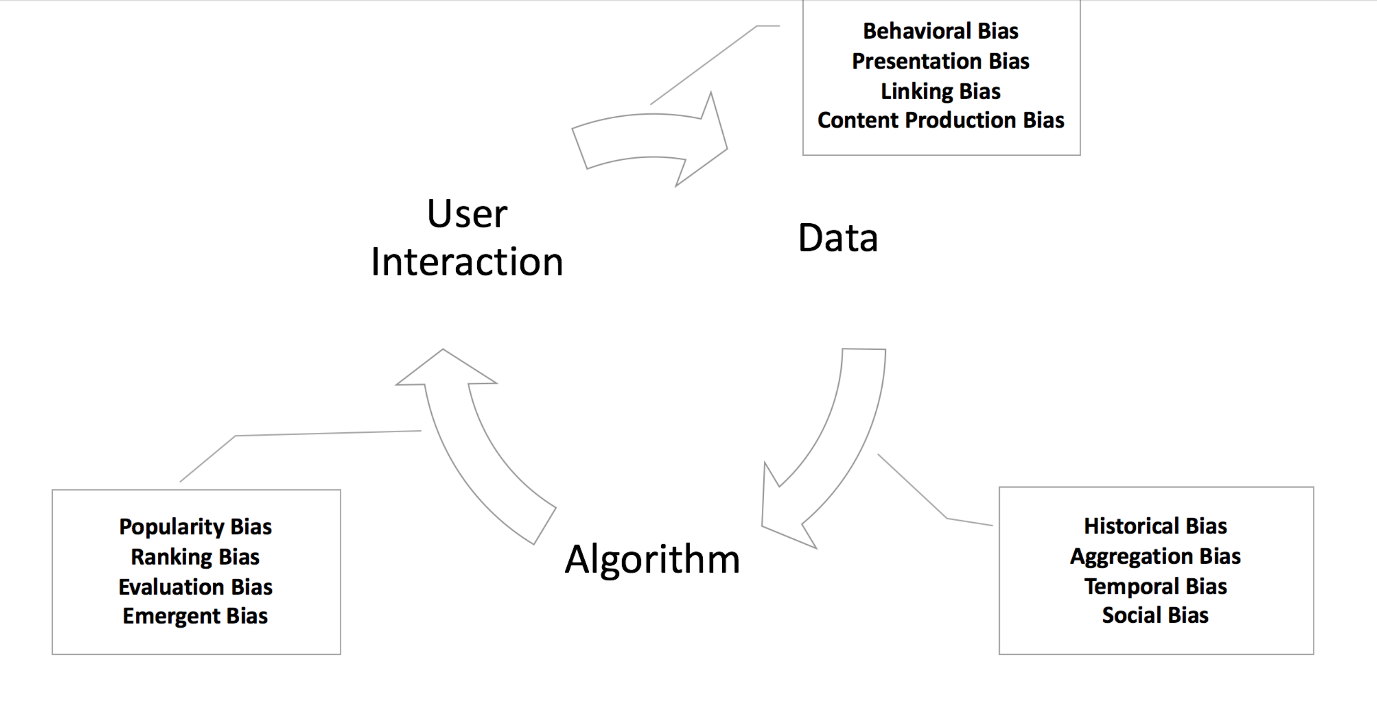
Bias in Practice
Persona
The user is interacting with the original dataset before modeling
Analyst/
Warfighter
Citizen
Data Scientist
The Data is being processed by the ML algorithm
ML Engineer
ML Expert / Researcher

Slide 15
ML/AI Bias and Fairness
Bias in Data
Types of Bias
Bias in Practice
Bias Variance Tradeoff
Algorithmic Fairness
Types of Discrimination
Combatting Bias

Slide 16
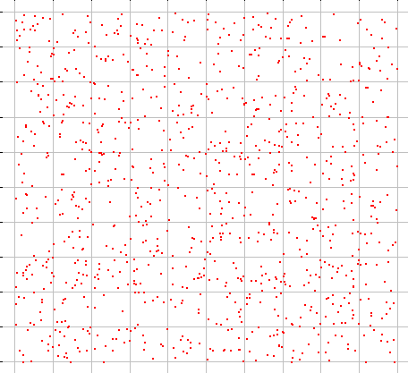
Predicting from Samples
Most datasets are samples from an infinite population.
We are most interested in models of the population, but we have access only to a sample of it.
For datasets consisting of (X,y)
features X + label y
a model is a prediction y = f(X)
We train on a training sample D and we denote the model as f_{D}(X)

Slide 17
Bias and Variance
Our data-generated model $f_{D}\left(X\right)$ is a statistical estimate of the true function $f\left(X\right)$.
Because of this, its subject to bias and variance:
Bias: if we train models $f_{D}\left(X\right)$ on many training sets $D$, bias is the expected difference between their predictions and the true $y$’s.
i.e. $Bias=E\left[f_{D}\left(X\right)−y\right]$
E[] is taken over points X and datasets D
Variance: if we train models $f_{D}(X)$on many training sets $D$, variance is the variance of the estimates:
$$Variance =E\left[{\left(f_{D}\left(X\right)−\overline{f}\left(X\right)\right)}^{2}\right]$$
Where $\overline{f}\left(X\right)=E\left[f_{D}\left(X\right)\right]$ is the average prediction on X.

Slide 18
Bias and Variance Tradeoff
There is usually a bias-variance tradeoff caused by model complexity.
Complex models (many parameters) usually have lower bias, but higher variance.
Simple models (few parameters) have higher bias, but lower variance.

Slide 19
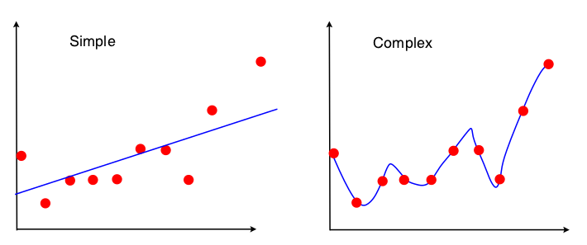
Bias and Variance Tradeoff
e.g. a linear model can only fit a straight line. A high-degree polynomial can fit a complex curve. But the polynomial fits the individual sample, and not the underlying population. Its shape can vary from sample to sample, so it has high variance.

Slide 20
Bias and Variance Tradeoff
The total expected error is
$${Bias}^{2}+Variance$$
Because of the bias-variance trade-off, we want to balance these two contributions.
If $Variance$ strongly dominates, it means there is too much variation between models. This is called over-fitting.
If $Bias$ strongly dominates, then the models are not fitting the data well enough. This is called under-fitting.

Slide 21
ML/AI Bias and Fairness
Bias in Data
Types of Bias
Bias in Practice
Bias Variance Tradeoff
Algorithmic Fairness
Types of Discrimination
Combatting Bias

Slide 22
Algorithmic Fairness
Broadly, algorithmic fairness is the absence of any prejudice or favoritism towards the an feature/observation, or a group within an underlying dataset based on their intrinsic or acquired traits in the context of ML decision-making.
Even though fairness is an incredibly desirable quality in society, it can be surprisingly difficult to achieve in practice.
Sources of Bias: These (1) personas interacts with the (2) model and the (3) data
Notes:
Fighting against bias and discrimination has a long history in philosophy and psychology, and recently in machine-learning. However, in order to be able to fight against discrimination and achieve fairness, one should first define the notion of fairness.
Philosophy and psychology have tried to define the concept of fairness long before computer science started exploring it. The fact that no universal definition of fairness exists shows the difficulty of solving this problem [112].
Different preferences and outlooks in different cultures lend a preference to different ways of looking at fairness, which makes it harder to come up with just a single definition that is acceptable to everyone in a situation.
Indeed, even in computer science, where most of the work on proposing new fairness constraints for algorithms has come from the West, and a lot of these papers use the same datasets and problems to show how their constraints perform, there is still no clear agreement on which constraints are the most appropriate for those problems.

Slide 23
ML/AI Bias and Fairness
Bias in Data
Types of Bias
Bias in Practice
Bias Variance Tradeoff
Algorithmic Fairness
Types of Discrimination
Combatting Bias

Slide 24
Types of Discrimination
(1) Direct Discrimination. Direct discrimination happens when protected attributes of individuals explicitly result in non-favorable outcomes toward them.
(2) Indirect Discrimination. In Indirect discrimination, individuals appear to be treated based on seemingly neutral and non-protected attributes; however, protected groups or individuals still get to be treated unjustly as a result of implicit effects from their protected attributes.
(3) Systemic Discrimination. Systemic discrimination refers to policies, customs, or behaviors that are a part of the culture or structure of an organization that may perpetuate discrimination against certain subgroups of the population.
(4) Statistical Discrimination. Statistical discrimination is a phenomenon where decision-makers use average group statistics to judge an individual belonging to that group.
(5) Explainable Discrimination. Differences in treatment and outcomes amongst different groups can be justified and explained via some attributes in some cases.
(6) Unexplainable Discrimination. In contrast to explainable discrimination, there is unexplainable discrimination in which the discrimination toward a group is unjustified and therefore considered illegal.
Notes:
Typically, there are some traits identified by law on which it is illegal to discriminate against, and it is usually these traits that are considered to be "protected" or "sensitive" attributes in computer science literature. A list for some of these protected attributes is provided in Table 4 as specified in the Fair Housing and Equal Credit Opportunity Acts (FHA and ECOA) [29].
(e.g., the residential zip code of a person can be used in decision making processes such as loan applications. However, this can still lead to racial discrimination as despite the fact that zip code appears to be a non-sensitive attribute, it may correlate with race because of the population of residential areas.) [136].
For example, a restaurant fulfilling customers’ requests that lead to discriminatory placement of employees would be systemic discrimination. [108] found that employers overwhelmingly preferred competent candidates that were culturally similar to them personally, and shared similar experiences and hobbies. If the decision-makers happen to belong overwhelmingly to certain subgroups, this may result in discrimination against competent candidates that do not belong to these subgroups.
It usually occurs when the decision-makers (e.g., employers, or law enforcement officers) use an individual’s obvious, recognizable characteristics as a proxy for either hidden or more-difficult-to-determine characteristics, that may actually be relevant to the outcome [102].
In situations where these differences are justified and explained, it is not considered to be illegal discrimination and hence called explainable [64]. For instance, authors in [64] state that in the UCI Adult dataset [6], a widely used dataset in the fairness domain, males on average have a higher annual income than females. However, this is because on average females work fewer hours than males per week. Work hours per week is an attribute that can be used to explain low income which needs to be considered. If we make decisions, without considering working hours, such that males and females end up averaging the same income, we will lead to reverse discrimination since we would cause male employees to get lower salary than females. Therefore, explainable discrimination is acceptable and legal as it can be explained through other attributes like working hours. In [64], authors present a methodology to quantify the explainable and illegal discrimination in data. They argue that methods that do not take the explainable part of the discrimination into account may result in non-desirable outcomes, so they introduce a reverse discrimination which is equally harmful and undesirable. They explain how to quantify and measure discrimination in data or a classifier’s decisions which directly considers illegal and explainable discrimination.
Authors in [64] also present local techniques for removing only the illegal or unexplainable discrimination, allowing only for explainable differences in decisions. These are pre-processing techniques that change the training data such that it contains no unexplainable discrimination. We expect classifiers trained on this pre-processed data to not capture illegal or unexplainable discrimination.

Slide 25
Combatting Bias
(1) Pre-processing. Pre-processing techniques try to measure then transform the data so that the underlying discrimination is removed. If the algorithm is allowed to modify the training data, then pre-processing can be used.
(2) In-processing. In-processing techniques try to modify and change state-of-the-art learning algorithms in order to remove discrimination during the model training process. If it is allowed to change the learning procedure for a machine learning model, then in-processing can be used during the training of a model— either by incorporating changes into the objective function or imposing a constraint
(3) Post-processing. Post-processing is performed after training by accessing a holdout set which was not involved during the training of the model. If the algorithm can only treat the learned model as a black box without any ability to modify the training data or learning algorithm, then only post-processing can be used in which the labels assigned by the black-box model initially get reassigned based on a function during the post-processing phase

Slide 26
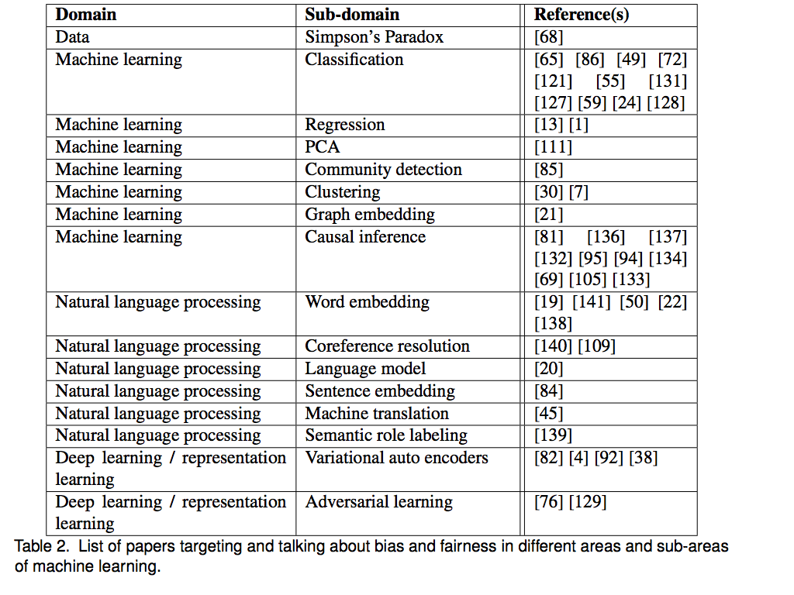
Combatting Bias

Slide 27
ML/AI Governance
ML/AI Governance Framework
Transparency
Why Transparency?
Transparency of What?
Transparency Risks
Accountability
Why do we Need Accountability?
Explainability
Managing the ML Lifecycle: MLflow

Slide 28
ML/AI Governance Framework
At the higher level two approaches are considered, principles (e.g. people, processes, and technology) vs rules-based approaches and regulation related to algorithms as a single regulatory category or rather as a kind of helper technology that should be regulated as a component of other technologies.
Consideration of principles vs rules-based approaches in the context of technology-related governance reveals that much of the existing literature/practice focuses on risks-oriented principles based approaches.
Methods emphasize maximizing the benefits and minimizing the risks that arise from the use of the technology by allocating resources in proportion to risks to society, considering both the impacts themselves and the likelihood that they happen, in order to establish appropriate levels of control.
One common tool used to support risk-based approaches is an impact assessment.

Slide 29
Transparency
Depending on the type and use of an algorithmic decision system, the desire for algorithmic transparency may refer to one, or more of the following aspects:
code, logic, model, goals (e.g. optimization targets), decision variables, or some other aspect that is considered to provide insight into the way the algorithm performs.
Algorithmic system transparency can be global, seeking insight into the system behavior for any kind of input, or local, seeking to explain a specific input - output relationship.

Slide 30
Why Transparency?
We want systems to be transparent not to satisfy idle curiosity, but to help achieve important social goals related to accountability:
We want to inspect an algorithmic system’s data and algorithms to:
Check for bias in the data and algorithms that affects the fairness of the system. (The mechanics, costs, and secondary effects are different when checking data vs. algorithms).
Check that the system is drawing inferences from relevant and representative data.
See if we can learn anything from the machine’s way of connecting and weighting the data - perhaps there’s a meaningful correlation we had not been aware of.
Look for, and fix, bugs.
Guard against malicious/adversarial data injection.

Slide 31
Why Transparency?
We want the hierarchy of goals and outcomes to be transparent so:
It can be debated and possibly regulated.
Regulators and the public can assess how well an algorithmic system has performed relative to its goals, and compared to the pre-algorithmic systems it may be replacing or supplementing.
We want an organization's compliance status to be public so:
Regulators can hold the organization accountable in case of failure.
The public can evaluate the trustworthiness of the organization, so people can make informed decisions as users about the services offered, and so citizens can become better informed about the benefits, risks, and trade-offs of algorithmic-based services overall.

Slide 32
Transparency of What?
There are seven broad areas of machine learning systems about which transparency might be demanded:
1. Data (Datasheets for Datasets). The transparency of the data used by the algorithmic system -- in particular by machine learning and deep learning algorithms -- can refer to the raw data, to the data’s sources, to how the data were preprocessed, to the methods by which it was verified as unbiased and representative (including looking for features that are proxies for information about protected classes), or to the processes by which the data are updated and the system is retrained on them.
2. Algorithms (Model Cards). The transparency of the systems' algorithms can refer to testing its output against inputs for which we know the proper output, reducing the variables to the most significant so we can validate them, testing the system with counterfactuals to see if prejudicial data is infecting the output, a third party code review, analysis of how the algorithms work, inspection of internal and external bug reports, or assurance the software development processes are sound.
3. Goals. Algorithmic systems can also be transparent about their goals. When a system has multiple goals, this would mean being transparent about their relative priorities.
4. Outcomes. Manufacturers or operators could be required to be transparent about the outcomes of the deployment of their algorithmic systems, including the internal states of the system (how worn are the brakes of an AV? how much electricity used?), the effects on external systems (how many accidents, or times it’s caused another AV to swerve?), and computer-based interactions with other algorithmic systems (what communications with other AVs, what data fed into traffic monitoring systems?).
5. Compliance. Manufacturers or operators may be required to be transparent about their overall compliance with whatever transparency requirements have been imposed upon them. In many instances, we may insist that these compliance reports are backed by data that is inspectable by regulators or the general public.
6. Influence. Just as the public has an interest in knowing if an article in a newspaper was in fact paid for by an interested party, the public may have an interest in knowing if any element of the AI process was purposefully bent to favor a particular outcome (e.g. boosting).
7. Usage. Users may want to know what personal data a system is using, either to personalize outcomes or as data that can train the system to refine it or update it.
Notes:
There are seven broad areas of machine learning systems about which transparency might be demanded:
1. Data. The transparency of the data used by the algorithmic system -- in particular by machine learning and deep learning algorithms -- can refer to the raw data, to the data’s sources, to how the data were preprocessed, to the methods by which it was verified as unbiased and representative (including looking for features that are proxies for information about protected classes), or to the processes by which the data are updated and the system is retrained on them.
2. Algorithms. The transparency of the systems' algorithms can refer to testing its output against inputs for which we know the proper output, reducing the variables to the most significant so we can validate them, testing the system with counterfactuals to see if prejudicial data is infecting the output, a third party code review, analysis of how the algorithms work, inspection of internal and external bug reports, or assurance the software development processes are sound.
3. Goals. Algorithmic systems can also be transparent about their goals. When a system has multiple goals, this would mean being transparent about their relative priorities. For example, the AI driving autonomous vehicles (AVs) might be aimed at reducing traffic fatalities, lowering the AVs’ environmental impact, reducing serious injuries, shortening transit times, avoiding property damage, and providing a comfortable ride. A manufacturer could be required to be transparent about those goals and their priority.
4. Outcomes. Manufacturers or operators could be required to be transparent about the outcomes of the deployment of their algorithmic systems, including the internal states of the system (how worn are the brakes of an AV? how much electricity used?), the effects on external systems (how many accidents, or times it’s caused another AV to swerve?), and computer-based interactions with other algorithmic systems (what communications with other AVs, what data fed into traffic monitoring systems?).
5. Compliance. Manufacturers or operators may be required to be transparent about their overall compliance with whatever transparency requirements have been imposed upon them. In many instances, we may insist that these compliance reports are backed by data that is inspectable by regulators or the general public.
6. Influence. Just as the public has an interest in knowing if an article in a newspaper was in fact paid for by an interested party, the public may have an interest in knowing if any element of the AI process was purposefully bent to favor a particular outcome (e.g. boosting).
7. Usage. Users may want to know what personal data a system is using, either to personalize outcomes or as data that can train the system to refine it or update it.

Slide 33
Transparency Risks
Potential costs include:
Regulatory bodies have to have staff sufficient to oversee compliance.
Businesses and other organizations have to create and maintain the processes, code, and legal oversight required by the regulatory bodies. (e.g. Mlflow).
Transparency might put justifiable trade secrets at risk.
Public access to data can flame interest-driven controversies via the untutored or unscrupulous misuse of data.
The requirement for transparency can lead to the use of algorithms that are suboptimal for their purposes, resulting in what can be serious harms when compared with achievable goods.
Access to data that seems innocuous can lead to breaches of personal privacy by clever and determined hackers (e.g. privacy vs. utility).
Increased transparency of algorithms can make them easier to hack for malicious purposes (e.g. adversarial ML / data or model poisoning).

Slide 34
Accountability
Accountability serves to ensure responsible development and use of algorithmic systems such that they improve human rights and benefit society
Accountability is primarily a legal and ethical obligation on an individual or organization to account for its activities, accept responsibility for them, and to disclose the results in a transparent manner.
Transparency, logs of data provenance, code changes and other record keeping are important technical tools but ultimately accountability depends on establishing clear chains of responsibility.
Accountability ultimately lies with a (legal) person

Slide 35
Why Accountability
In the context of algorithmic systems, the challenges arise from:
Complex interactions between sub-systems and data sources, some of which might not be under the control of the same entity (e.g. systems relying on data acquired through data brokers who rely on data sources that use algorithmic inference to aggregate over 'similar' data subjects). A governance framework for algorithmic accountability and transparency
Unexpected outcomes associated with the impossibility of testing against all possible input conditions when there are no methods for generating formal proofs for the system’s performance.
Difficulties in translating algorithmically derived concepts (e.g. clustering algorithm results that segment populations based on large numbers of input variables) into human understandable concepts (e.g. ethnic affiliation) resulting in incorrect interpretations of the meaning of algorithmic results.
Information asymmetries arising from algorithmic inferences and black box processes that make it all but impossible for data subjects to gage which, potentially false, information might have resulted in a particular algorithmic outcome affecting them (including lack of knowledge that algorithmic processes were even involved).
Ubiquity of (small) algorithmic decisions which, if systematically biased, may accumulate to have significant impacts on people even though no single decision would have achieved that legal threshold (e.g. impact on personal development due to reinforcement of racial/gender stereotypes by algorithmic recommendations).
Purposeful injections of adversarial data to fool a system into making errors, often in ways that can be very difficult to detect.

Slide 36
Explainable Artificial Intelligence
Source: https://www.darpa.mil/program/explainable-artificial-intelligence

Slide 37

Introduction to

Slide 38
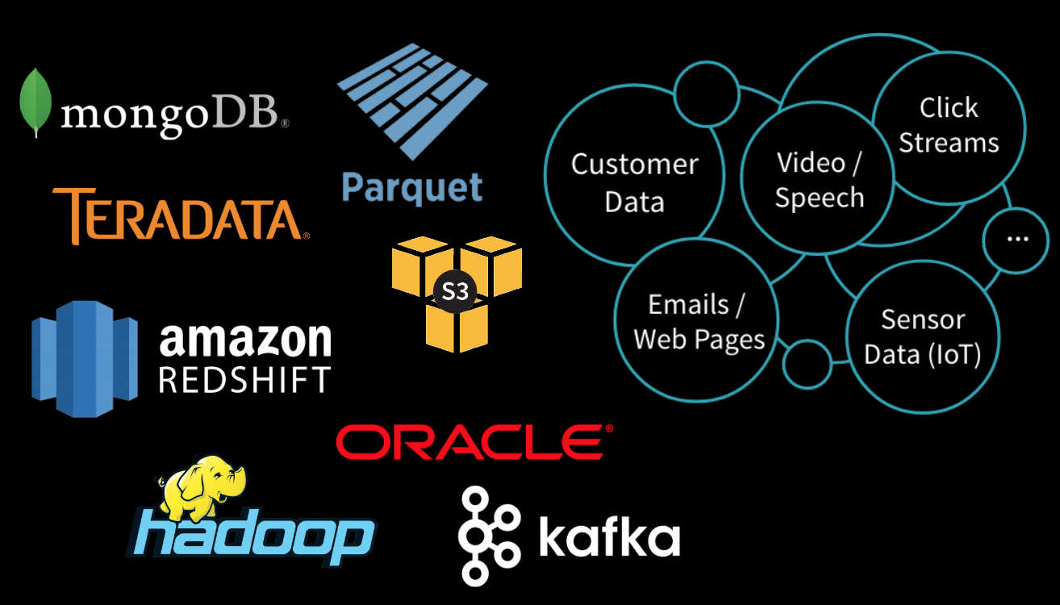
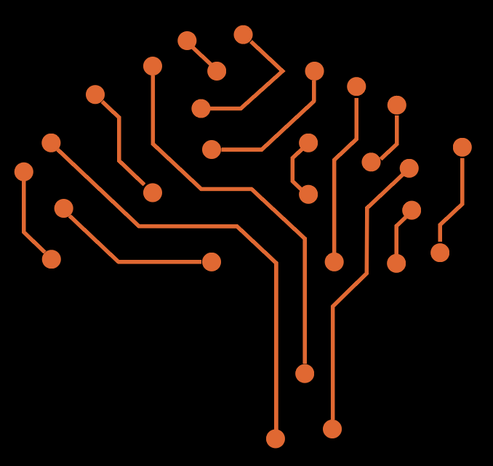
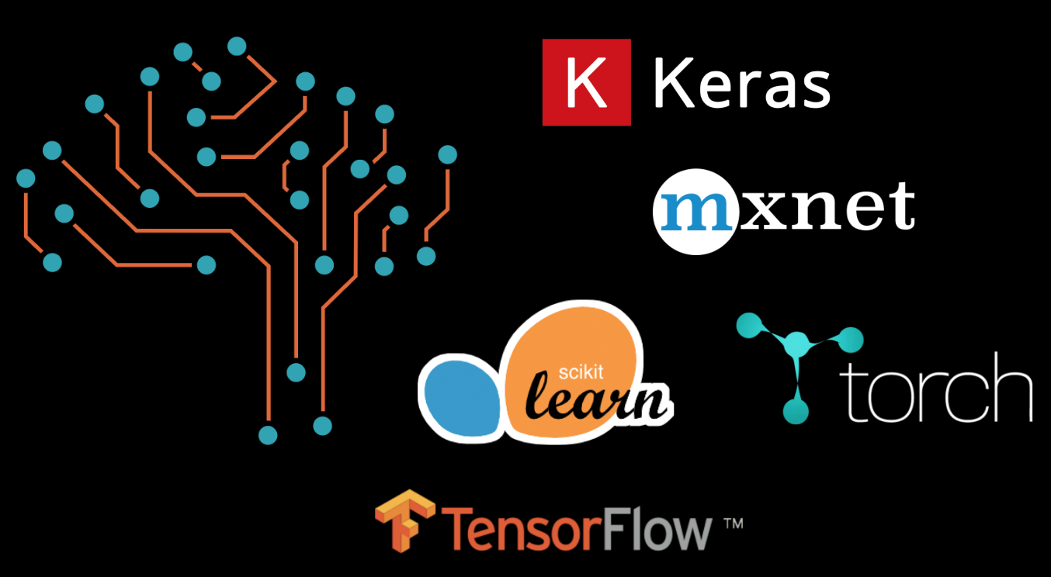
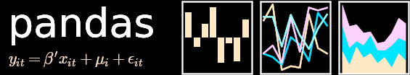



Data & ML Silos – Difficulty Productionizing
CLOUD ECOSTYSTEM
SANBOX / DEVELOPMENT
DATA SCIENCE ECOSTYSTEM
x
ETL & ML ENGINEERS / CLOUD & ANALYTIC DEVELOPERS
DATA ENGINEERS /
SCIENTISTS / VIZ
x
x
PRODUCTION ENVIRONMENT
ESTIMATOR
EVALUATOR
Raw Data
Data Prep
Featurize
Train
Score/Serve
Batch + Realtime
Monitor Alert, Debug
Production Logs
Update Features
Retrain

Slide 39




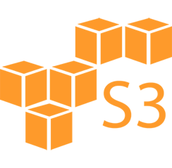













ML Lifecycle
μ
Tuning
λ
θ
Scale
An open source platform for the machine learning lifecycle
Data Prep
μ
Tuning
λ
Raw Data
Training
θ
Delta
Scale
Scale
Deploy
Model Exchange
Governance
Compliance
Risk
Scale

Slide 40











MLflow Components
Tracking
Projects
Models
Record and query experiments: code, data, config, results
Packaging format for reproducible runs on any platform
General model format that supports diverse deployment tools
Python or REST API
Project Spec
Inference Code
Local Execution
Model Format
Notebooks
Code
Flavor 1
Flavor 2
Batch & Stream
Scoring
UI
Config
Data
Remote Execution
Local Apps
Cloud Serving
Tools
my_model/ ├── MLmodel │ │ │ │ │ └── estimator/ ├── saved_model.pb └── variables/ ...
my_project/ ├── Mlproject
| │ │ │ │ │ ├── conda.yaml ├── main.py └── model.py ...
API
run_id: 769915006efd4c4bbd662461 time_created: 2018-06-28T12:34 flavors: tensorflow: saved_model_dir: estimator signature_def_key: predict python_function: loader_module: mlflow.tensorflow
conda_env: conda.yaml entry_points: main: parameters: training_data: path lambda: {type: float, default: 0.1} command: python main.py {training_data} {lambda}
Cloud Jobs
Parameters: key-value inputs to your code
Metrics: numeric values (can update over time)
Artifacts: arbitrary files, including models
Source: what code ran?
$ mlflow run git://<my_project>
mlflow.run(“git://<my_project>”, ...)
Notes:
Dive into each of these

Slide 41
Workflows and Model Registry
Workflows
Model Registry
Easy sharing + editing of multi-step pipelines
Pipelines: Define in code and edit in UI
Automatically reuse results
Runs on existing job schedulers like Apache Airflow
Manage, tag & version models in Mlflow server
Promote any model in the Mlflow Models format
Deploy to inference systems
See model users and add metadata

Slide 42

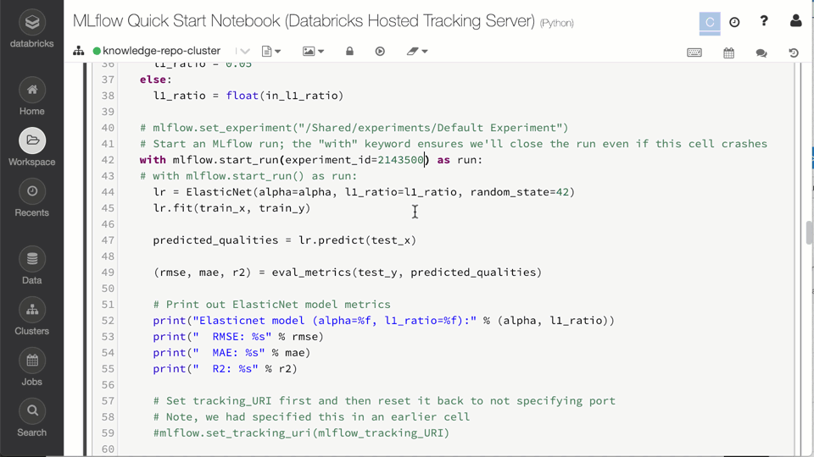
Experiment Tracking
Record runs, and keep track of models parameters, results, code, and data from each experiment and in one place.
Managed MLflow Provides:
Pre-configured MLflow tracking server
Databricks Workspace & Notebooks UI integration
S3, Azure Blob Storage, Google Cloud for artifacts storage
Experiments management via role based Access Control Lists (ACLs)

Slide 43
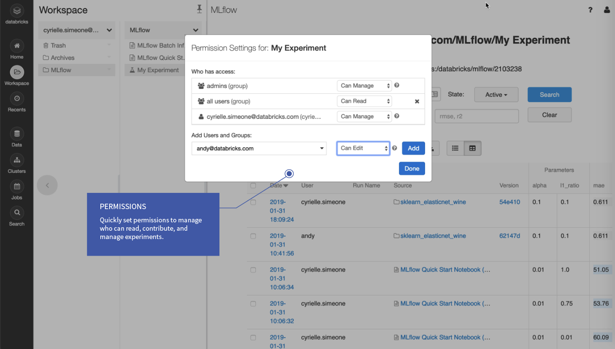

Slide 44

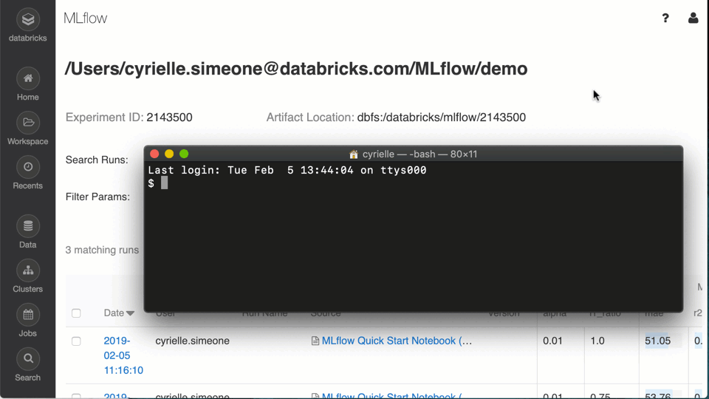
Reproducible Projects
Build composable projects, capture dependencies and code history for reproducible results, and share projects with peers.
Managed MLflow Provides:
Support for Git, Conda, and other file storage systems
Remote execution via command line as a Databricks Job

Slide 45
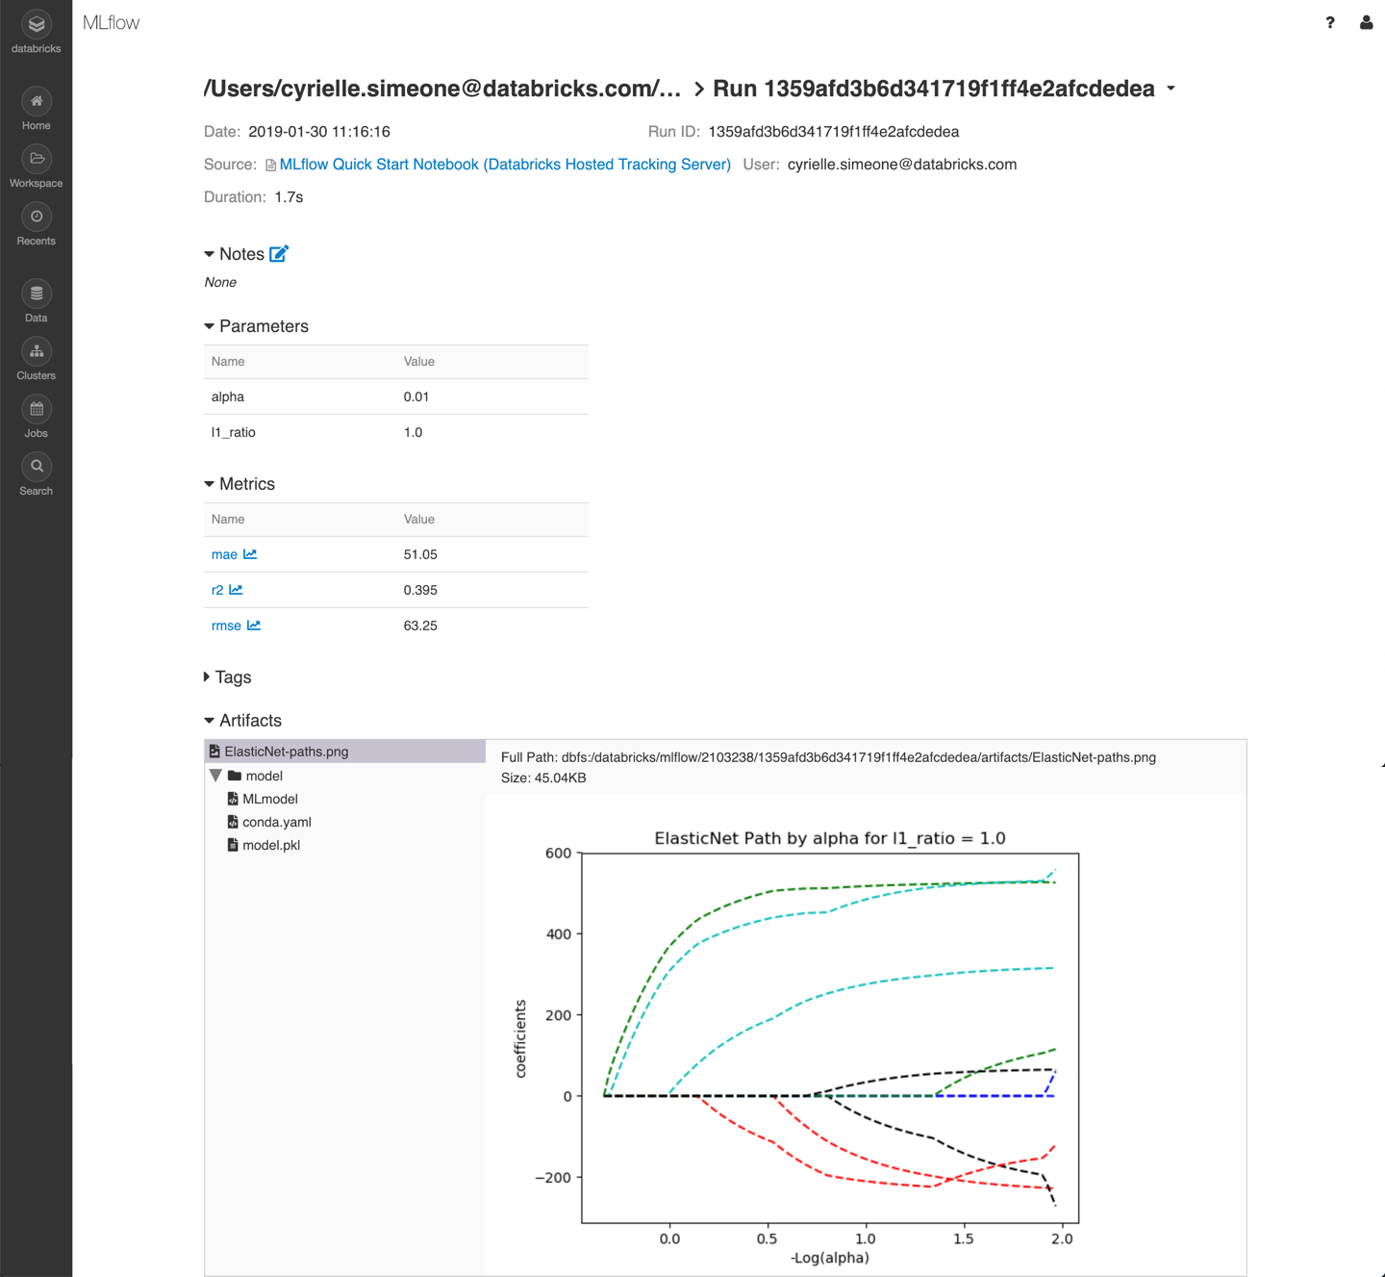

Slide 46
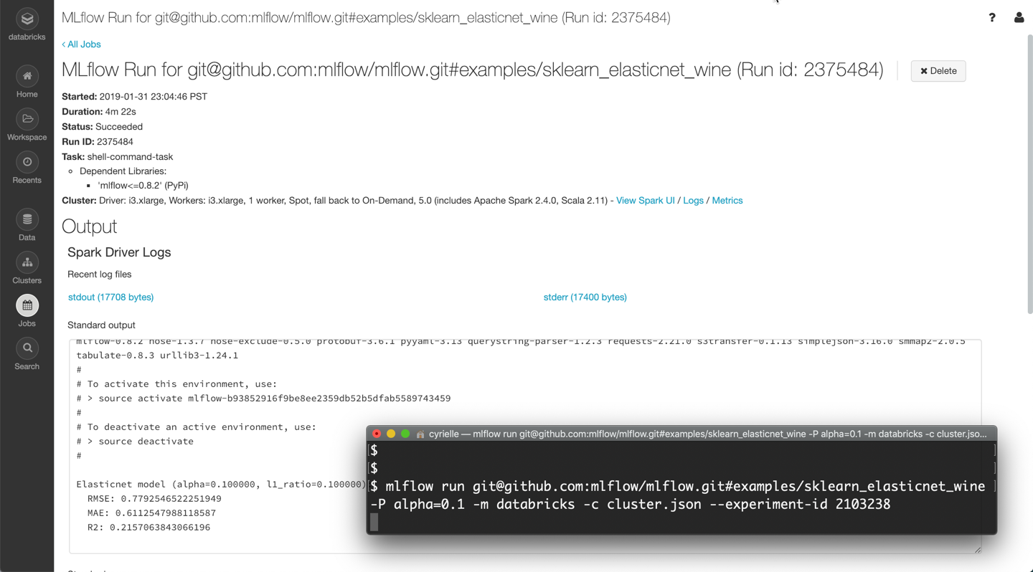

Slide 47

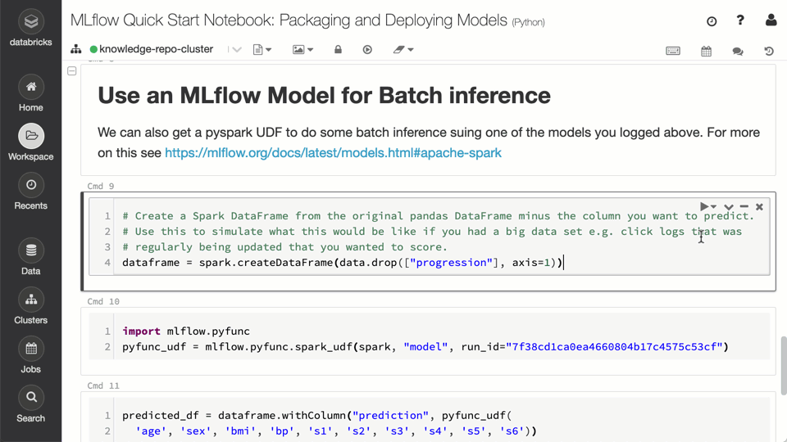
Model Deployment
Quickly deploy models to any platform based on your needs, locally or in the cloud, from experimentation to production.
Managed MLflow Supports:
Databricks Jobs and Clusters for Production Model Operations
Batch inference on Databricks (Apache Spark)
REST endpoints via Docker containers, Azure ML, or SageMaker

Slide 48

Standardizing the ML Lifecycle on Databricks Unified Analytics Platform
Prep Data
Build Model
Feed data to Models
Enrich data in experiments
Track Experiments
Reproduce experiments
Delta Lake
Databricks Runtime for ML
MLflow Project & Tracking
Deploy Model
Integrate with multiple clouds
Manage and monitor models
MLflow Models

Slide 49

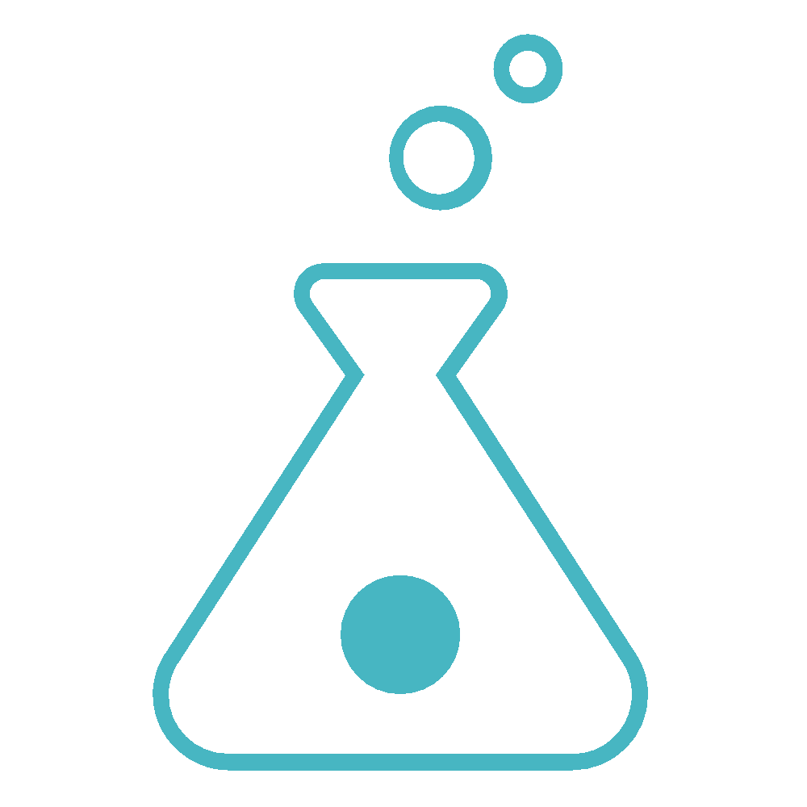


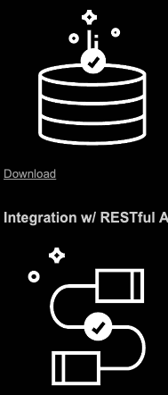


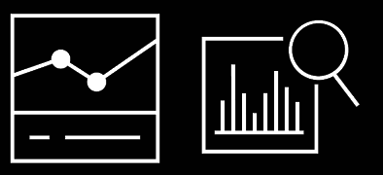


Unifying the End-to-end Data & ML Lifecycle
Overview
Prep Data
Build Model
Deploy/Monitor Model
Part of ML/AI Governance:
ML Lifecycle Management
Model Management
Experiment Management
Model Serving
Model Swap
Explainability
Bias
Transparency
Risk
AutoML
Hyperopt
Distributed Training
Online Serving
Partnerships
Batch
Scoring
BI & Reporting
Runtime and Environments
End to end ML lifecycle
Open, pluggable architecture
Notes:
Goal of the slide: Show how Databricks addresses the unification
Will not go into detail on data prep since this is well known
However, Delta provides some key features for ML
Will discuss things like time travel later
Build Model
Runtime and Environments provide the foundation to execute any DS/ML workload on Databricks
We provide AutoML, Hyperparameter tuning, and distributed training solutions that are ML framework agnostic
We complete our offering through key partnerships
Deploy/Monitor Model
Models are used in several ways
We provide integrations for the most popular online serving platforms, e.g. AML, AWS Sagemaker
We provide our own BI/Reporting tool but also integrate with the most popular BI platforms
End-to-end Lifecycle
Across the entire lifecycle, no matter what models are trained or where they are deployed, MLflow tracks experiments, artifacts, models, and metrics

Slide 50



Bias, Transparency, and Machine Learning and Artificial Intelligence Governance
THANK YOU!
bsharve@gmail.com; bsharve@gwu.edu; benjamin.harvey@databricks.com
Mehrabi, N., Morstatter, F., Saxena, N., Lerman, K., & Galstyan, A. (2019). A survey on bias and fairness in machine learning. arXiv preprint arXiv:1908.09635.
B. S. Harvey and S. Ji, "Cloud-Scale Genomic Signals Processing for Robust Large-Scale Cancer Genomic Microarray Data Analysis," in IEEE Journal of Biomedical and Health Informatics, vol. 21, no. 1, pp. 238-245, Jan. 2017.
Harvey, Benjamin.; Ji, S., "Cloud-Scale Genomic Signal Processing Classification Analysis for Gene Expression Microarray Data," Engineering in Medicine and Biology Society (EMBC), 2014 36th Annual International Conference of the IEEE , vol., no., pp.7152,7155, 26-30 August 2014

